Slide 1

Preparing
Machine Learning
Data Preprocessing
Using pandas, matplotlib, scikit-learn
경희대학교 컴퓨터공학과
2019102191 신주영

Slide 2
Importance of
Collecting and Preparing Data
To solve real problems with machine learning, data must be collected.
After collecting data, data preprocessing is required, such as setting the correct answer, modifying it in a form that is easy to learn, deleting unnecessary data, or adding other data.
Data preprocessing is such an important task that it accounts for 80% of the entire machine learning process.

Slide 3
Dependent variable and
Independent variable
Independent variable: The data based on prediction
Dependent variable: The data to be predicted
Independent variables are also called feature or input variable
Dependent variables are also called label or class label data

Slide 4
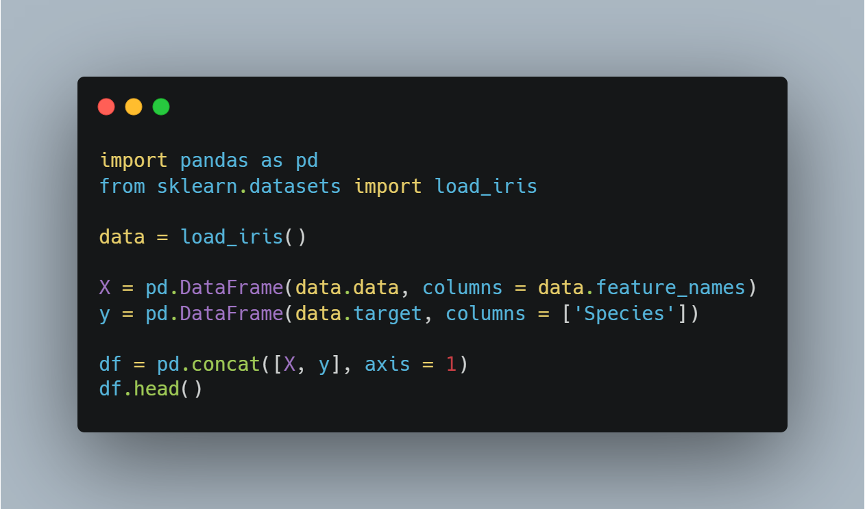
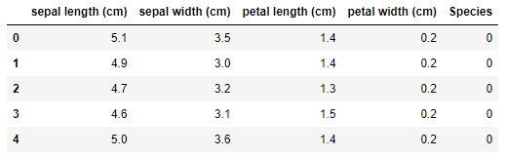
Looking for scikit-learn’s sample data get iris data set
Import pandas
Get iris datasets
Make data frame using pandas
Combine target data and feature data

Slide 5
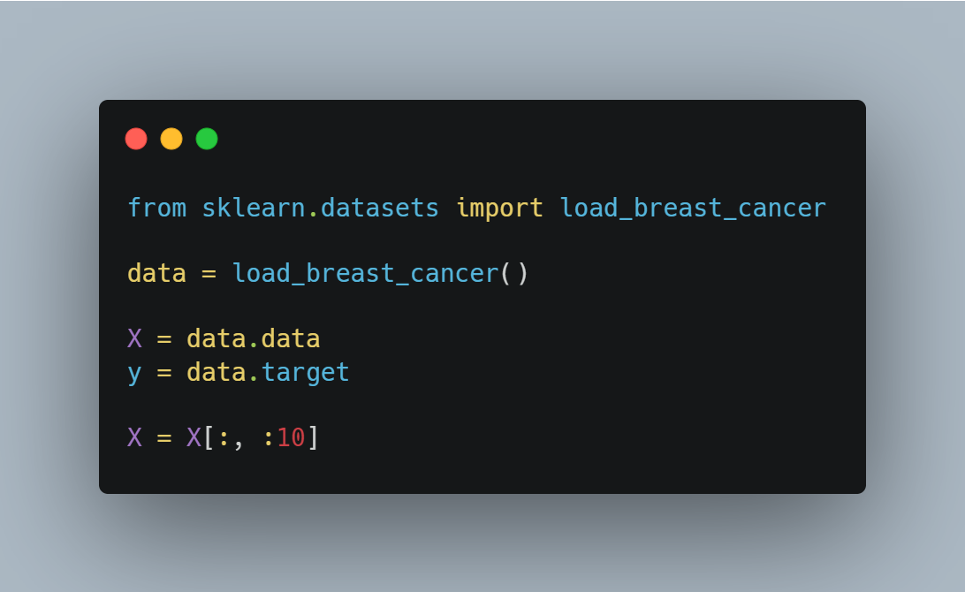
Example of supervised learning looking for example (breast cancer diagnosis data set, data preprocessing)
Import scikit-learn datasets
Get data from datasets
Set dependent variable and independent variable
Get only the data we want

Slide 6
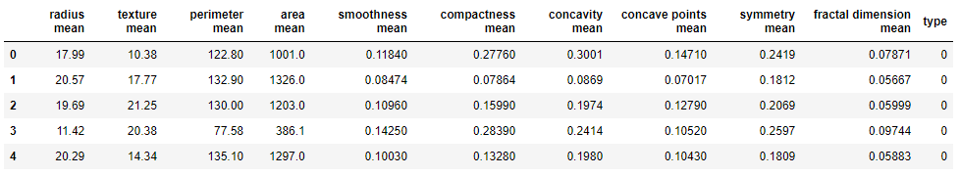
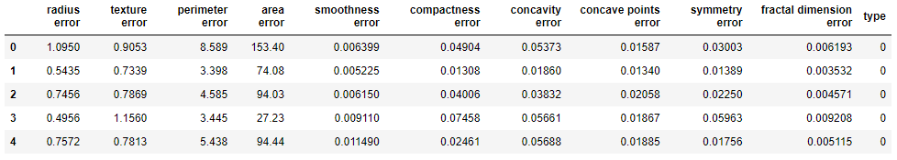
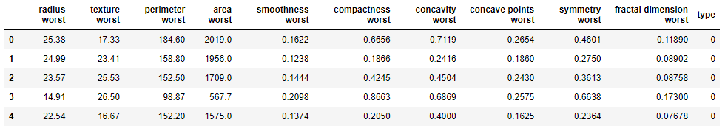
Example of supervised learning looking for example (breast cancer diagnosis data set, data preprocessing)

Slide 7
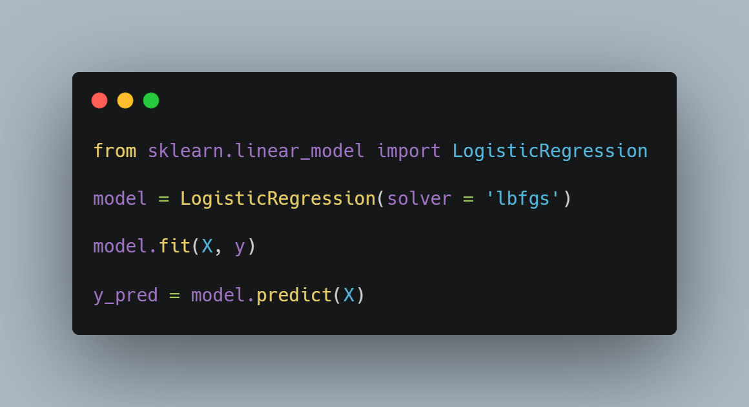
Example of supervised learning logistic regression
Import logistic regression from scikit-learn
Make instance of logistic regression class
Learn by executing the fit method in the model variable
The prediction is made by executing the predict method on the learned model

Slide 8
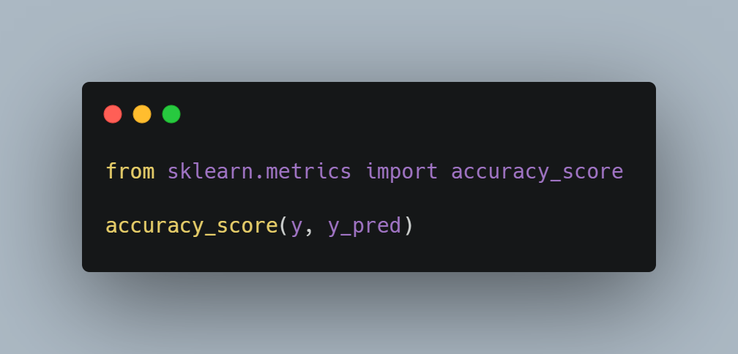
Accuracy evaluation
To calculate accuracy, use the scikit-learn’s accuracy_score function
The accuracy is output by entering the dependent variable y and the y_pred in the accuracy_score function

Slide 9
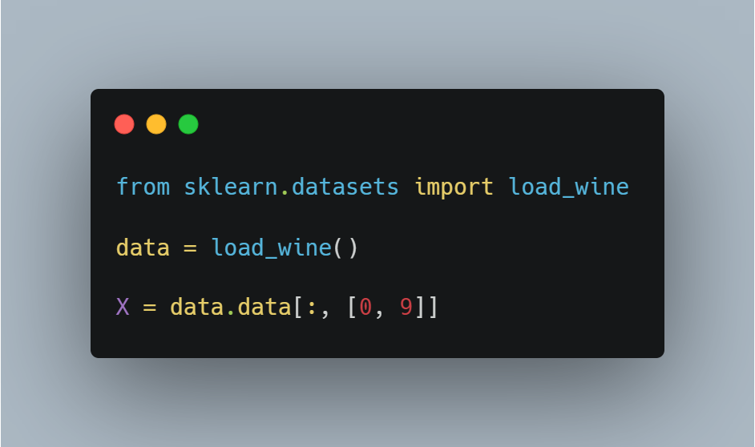
Example of unsupervised learning looking for example (wine data set, data preprocessing)
Import scikit-learn datasets
Get data from datasets
Set only dependent variable
Get only the data we want

Slide 10
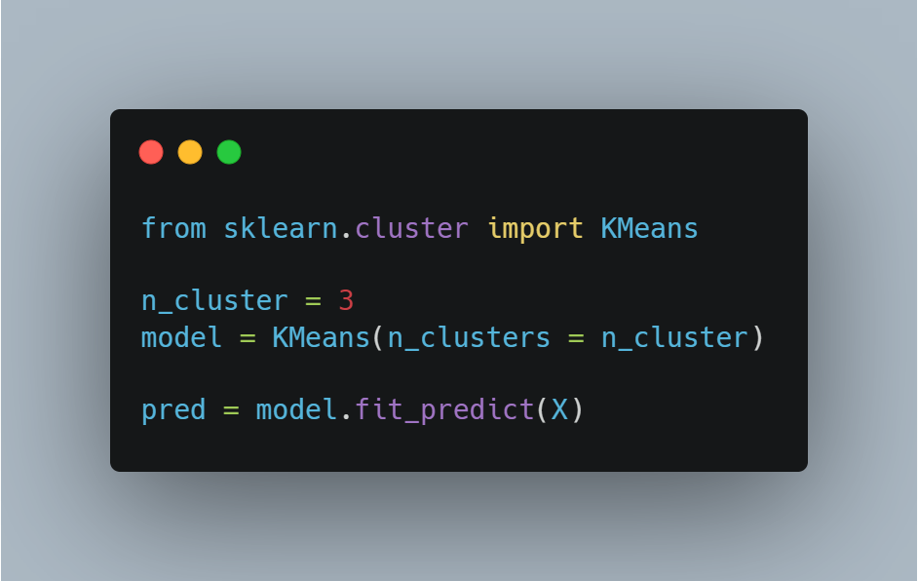
Example of unsupervised learning
K-Means algorithm
Import K-Means algorithm from scikit-learn
We will divide the data into three groups.(n_cluster = 3)
By using fit_predict method, we can do learning and prediction.

Slide 11
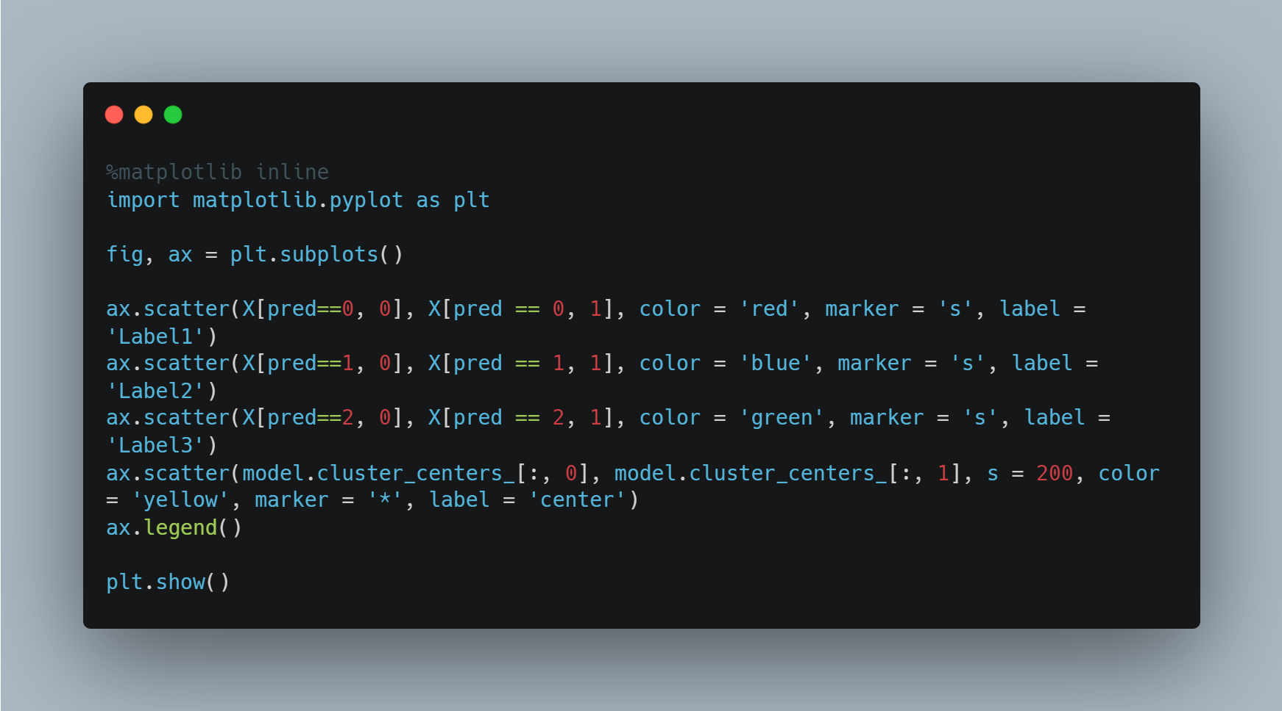
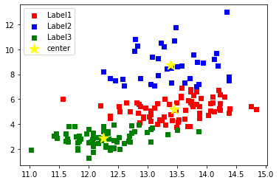
Confirmation of learning output
By using visualization, we’re going to confirm clustering results.

Slide 12
Visualization using python (pandas, matplotlib, seaborn)
We’re going to use visualization tool as a matplotlib mainly
This library can print beautifully axis, label, deployment, color, etc…
We’re going to use IDE as a Jupyter Notebook

Slide 13
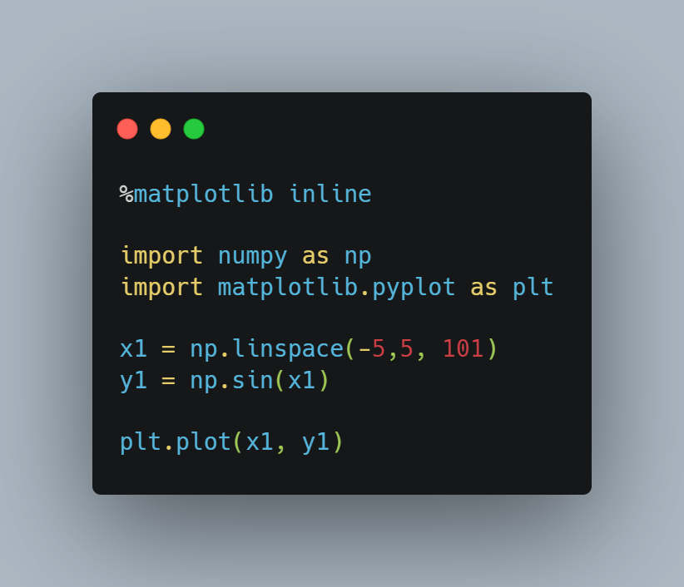
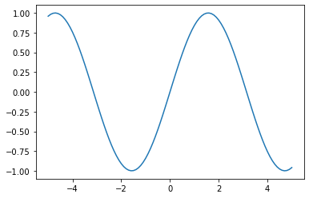
Graph output using matplotlib plt.plot(x1, y1)
Import numpy to make data set
Import matplotlib to make graph
We set the range from -5 to 5 to x1 to output a graph of the sin function in a specific range.

Slide 14
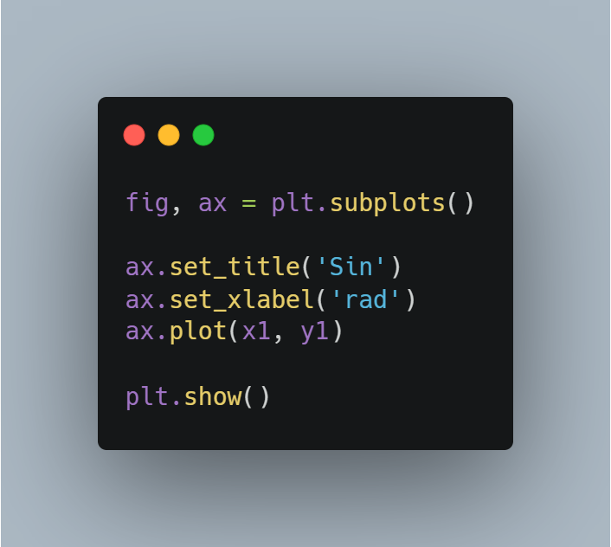
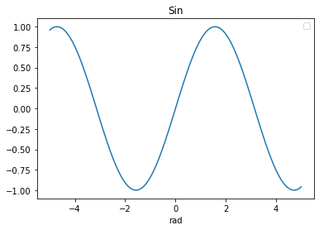
Graph output using matplotlib ax.plot(x1, y1)
fig is an object of the Figure class that generates a canvas, which is the entire area of the graph
ax is an object of the Axes class that generates a coordinate plane.

Slide 15
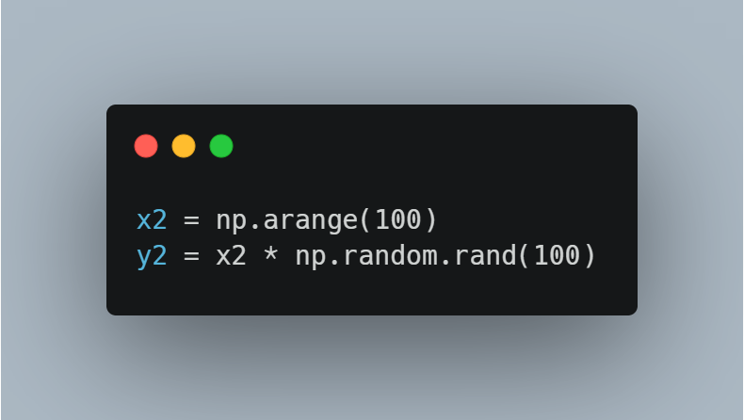
Output various graphs
Preparing Data
x2 stores an array from 0 to 99 as a number array function.
y2 stores the result obtained by multiplying an array of 100 random numbers from 0 to 1 by x2.

Slide 16
Select Graphs by Purpose
Bar graph: The data you want to express must all have the same unit. Discontinuous variables are good.
Line graph: Used for continuous data, such as changes over time
Scatter: Used to express the relationship between irregular intervals or bundles of data
Histogram: Use to determine the shape of the distribution
Box plot: Use to easily understand the alternative distribution of data

Slide 17
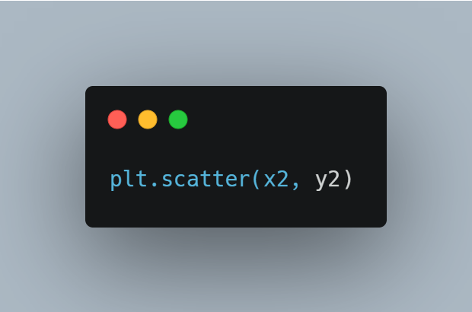
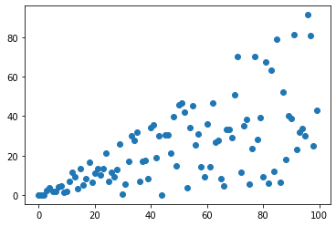
Output various graphs scatter

Slide 18
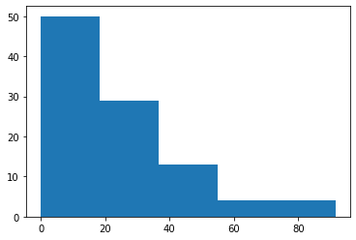
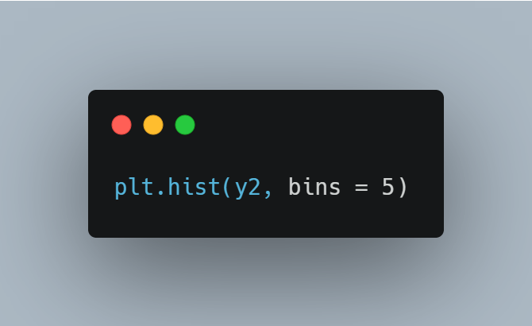
Output various graphs histogram

Slide 19
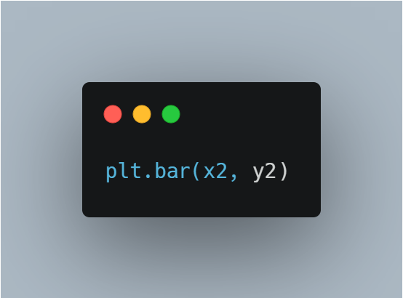
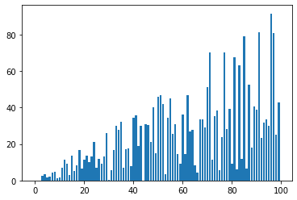
Output various graphs bar graph

Slide 20
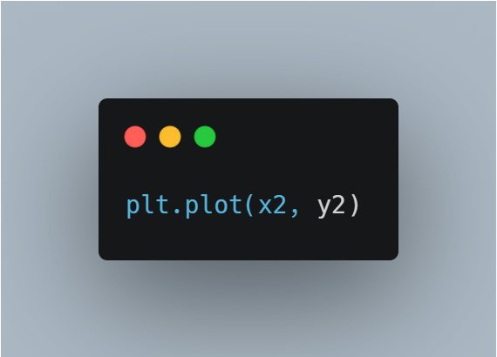
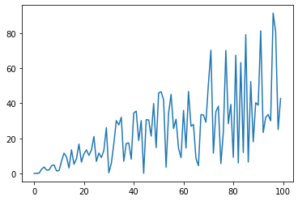
Output various graphs line graph

Slide 21
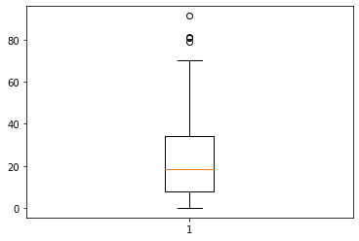
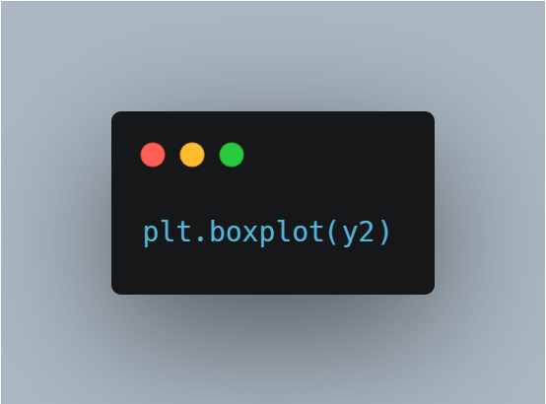
Output various graphs box plot

Slide 22
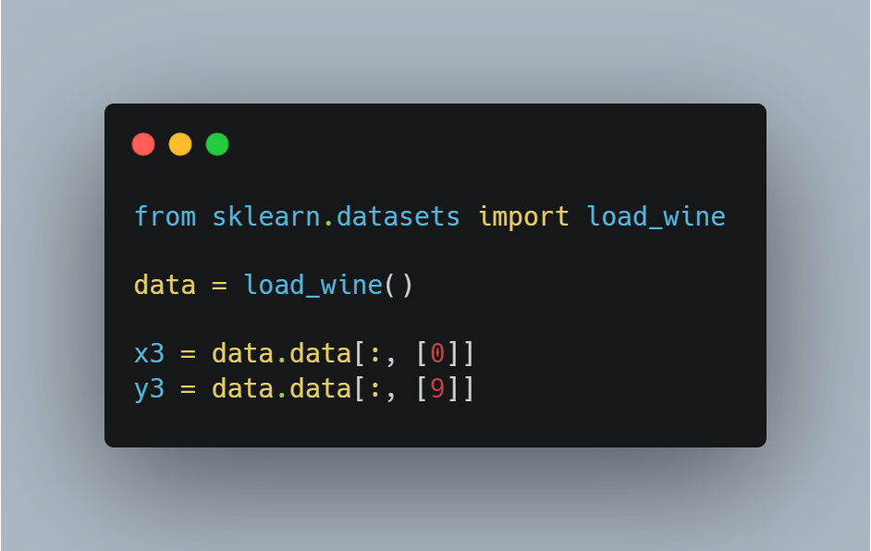
Visualization of wine data set data preprocessing
Import wine data set
Get only the data we want

Slide 23

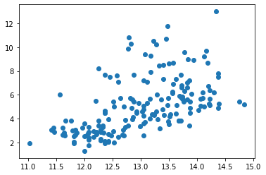
Visualization of wine data set scatter

Slide 24
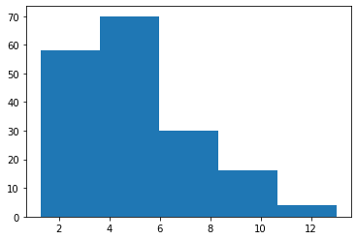

Visualization of wine data set histogram

Slide 25
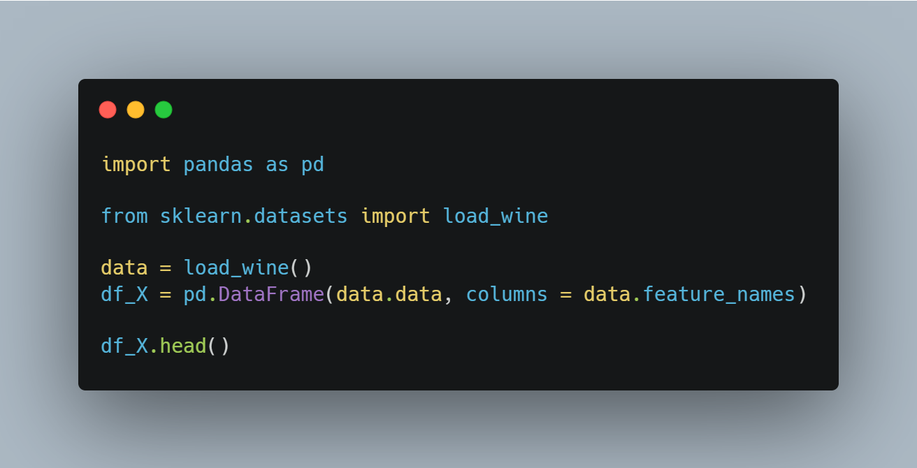
Use pandas to understand and handle data
Import pandas
Get wine datasets
Make data frame using pandas
Output a part of the dataset using the head method

Slide 26
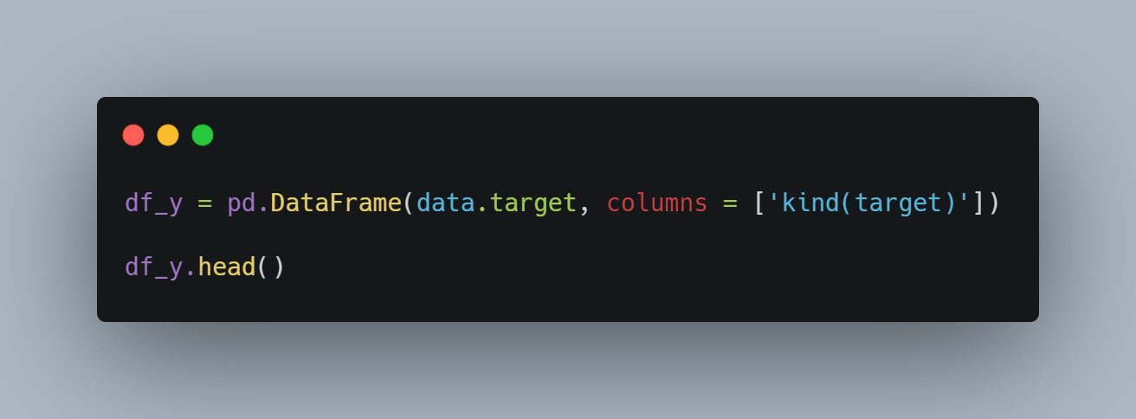
Use pandas to understand and handle data
Set column label as a ‘kind(target)’
Output a part of the dataset using the head method

Slide 27
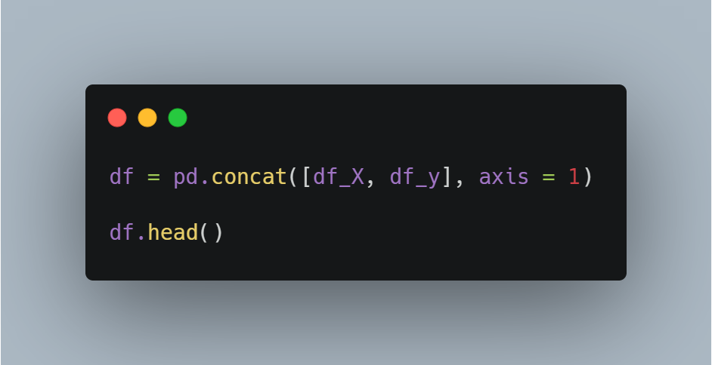
Use pandas to understand and handle data
Combine target data and feature data
Output a part of the dataset using the head method

Slide 28
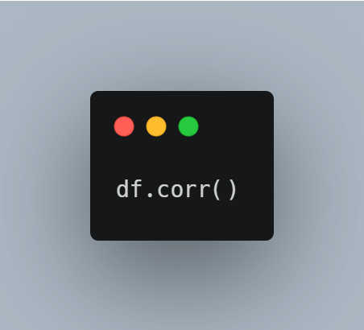
Use pandas to understand and handle data
corr() function outputs correlation coefficient
The correlation coefficient is a positive correlation as it approaches 1, and a negative correlation as it approaches -1, it is negative.
If it is close to 0, there is no correlation between the data.

Slide 29
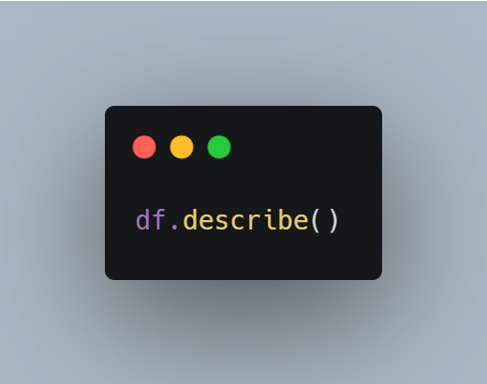
Use pandas to understand and handle data
describe() function outputs eight pieces of statistical information.
count, mean, std, min, 25%, 50%, 75%, max

Slide 30
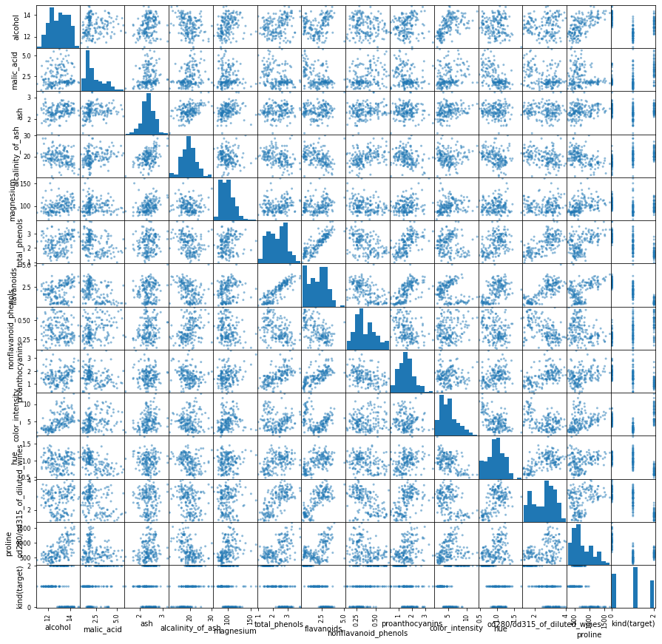
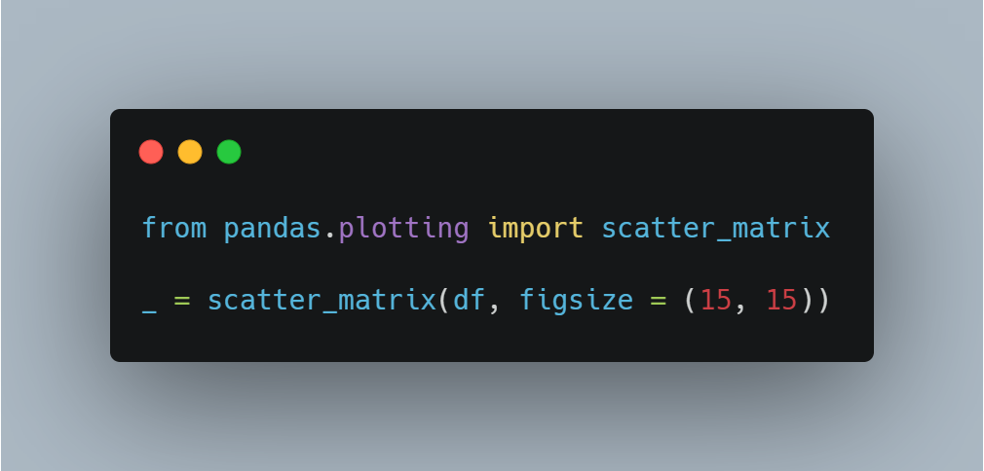
Use pandas to understand and handle data

Slide 31
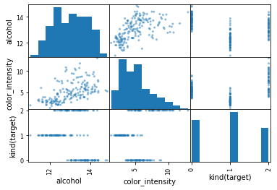
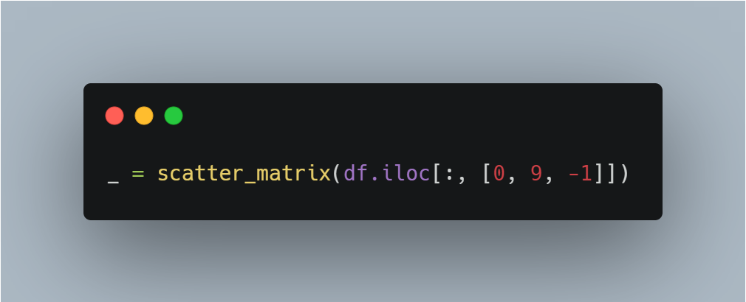
Use pandas to understand and handle data

